Slide 2
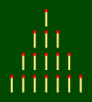
9.3 Nim Game (Game with matches)
Objectives
Count reliably up to 10 items.
Add single-digit numbers with totals to 10.
Subtract single-digit numbers from numbers up to 10.
Understand probability in order to decide the number of matches to remove.
Identify the possibilities of success each time we remove a match.

Slide 3
9.3 Nim Game (Game with matches)
Tools, Materials and Organisation
Sit the students in pairs opposite each other
Take 16 matches (or other objects like pebbles, pencils...) for each 2 players.
Prepare copies from the initial pattern for each student.
The lesson takes 45 minutes.

Slide 4
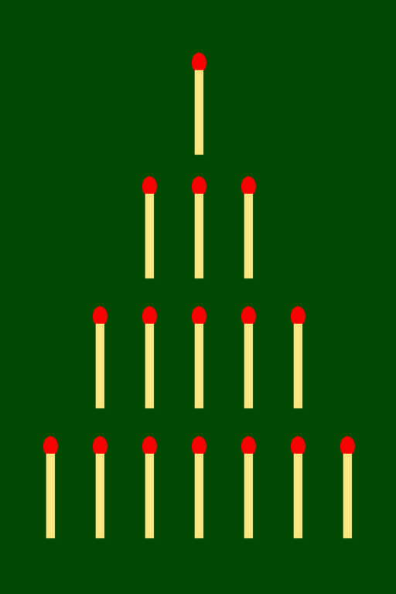
9.3 Nim Game (Game with matches)
Initial Pattern

Slide 5
9.3 Nim Game (Game with matches)
Description of the Lesson
First part of the lesson:
Give the players the 16 matches and a copy of the initial pattern.
Tell the players to put the 16 matches on the table following the initial pattern.
Practice taking out a given number of matches from only one row and counting how many matches remain.

Slide 6
9.3 Nim Game (Game with matches)
Description of the Lesson
Second part of the lesson:
Explain how to play the Nim game.
The participants play several times the Nim game until they have learnt how the game works.
Swap the players every five hands in order to practice the strategy against another player.
Put the students all together in a big group.
Talk about the strategy they have used to try to win the game.

Slide 7
9.3 Nim Game (Game with matches)
Useful Hints
Be sure the participants have understood the operation of the game.
Change the opponents often in order to test different strategies of playing.
The teacher should make students think over the strategy they can use to win the game.

Slide 8
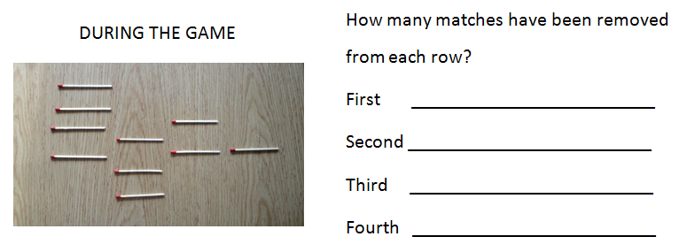
9.3 Nim Game (Game with matches)
ACTIVITIES I

Slide 9
9.3 Nim Game (Game with matches)
ACTIVITIES II

Slide 10
9.3 Nim Game (Game with matches)
LET’S PLAY THE GAME
Player A
Player B
Player B remove the last match…
Player A win the game!!

Slide 11
9.3 Nim Game (Game with matches)
LET’S PLAY THE GAME

Slide 12
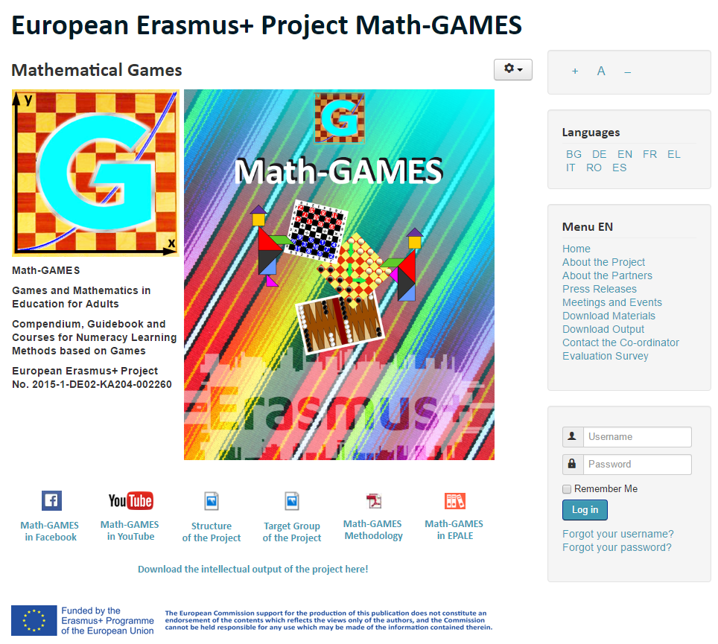
The result is: Play Games and learn Mathematics more easily.
Our Project-Website will help you: www.math-games.eu

